Slide 1
Phi-Bye
Jeremiah Webb
Solutions Architect Intern @illusjw

Slide 2
Agenda
Internship Experience & Goals
User Story, Requirements & Scope
Architecture Walkthrough
Demo
Cost

Slide 3
Whoami – Jeremiah Webb
Based in
Studying
Hobbies
Interests
SEA44 - Frontier
B.S Computer Science
M.S Cybersecurity Engineering
Baking
Private Pilot License
Ethical Hacking!
Psychology
Traveling – Japan

Slide 4
Internship Experience & Goals
Episode 5, The Interns Strikes back
Learn and Be Curious
Startup SA Role / Shadowing – Difference between Enterprise
Discover WWSO Security Domain & Security TFC
Learn AI/ML AWS Services
Bias For Action
Developer Certification – Achieved!
Security Specialization Certification - Scheduled
Deliver Results
Full CloudFormation Template for Data Pipeline
Full Demo & Expanded Scope for Project

Slide 5
User Story, Requirements & Scope
Doctor/Physician Recording Appointments
Serverless Data Preparation Pipeline for Machine Learning
Ability to Share Files, Redacted & Plaintext
HIPAA Compliance / Security

Slide 6
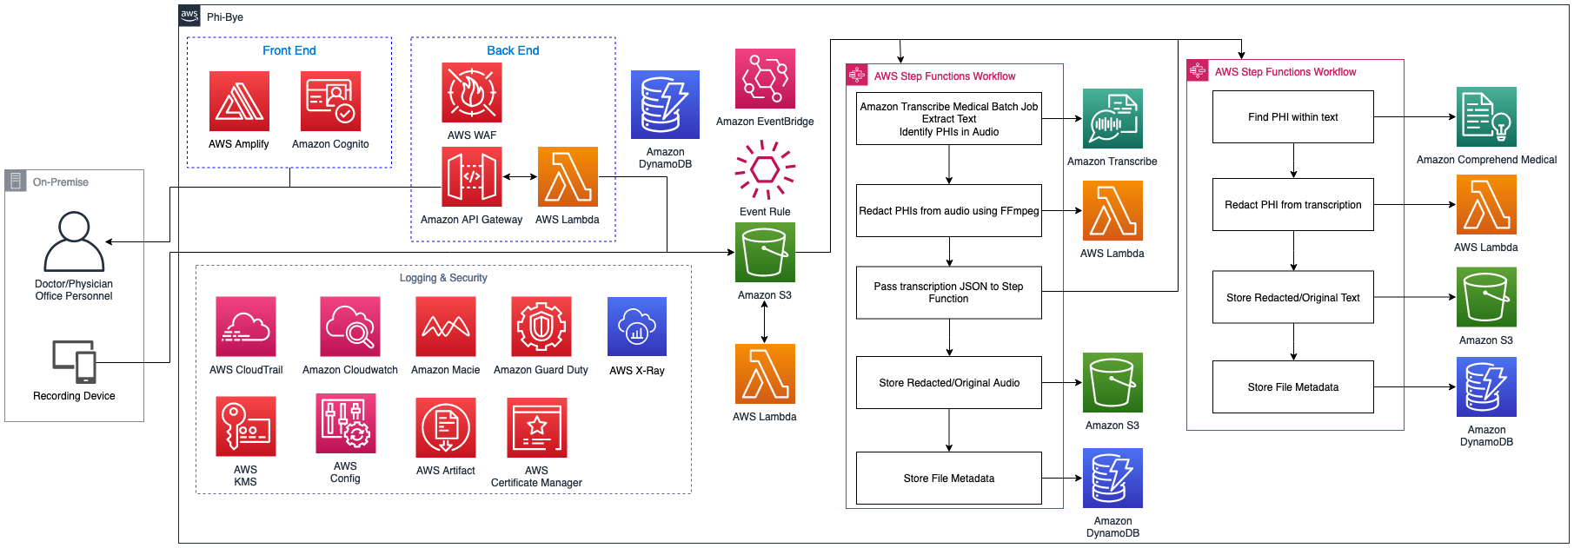
Architecture Walkthrough

Slide 7
DEMO

Slide 8
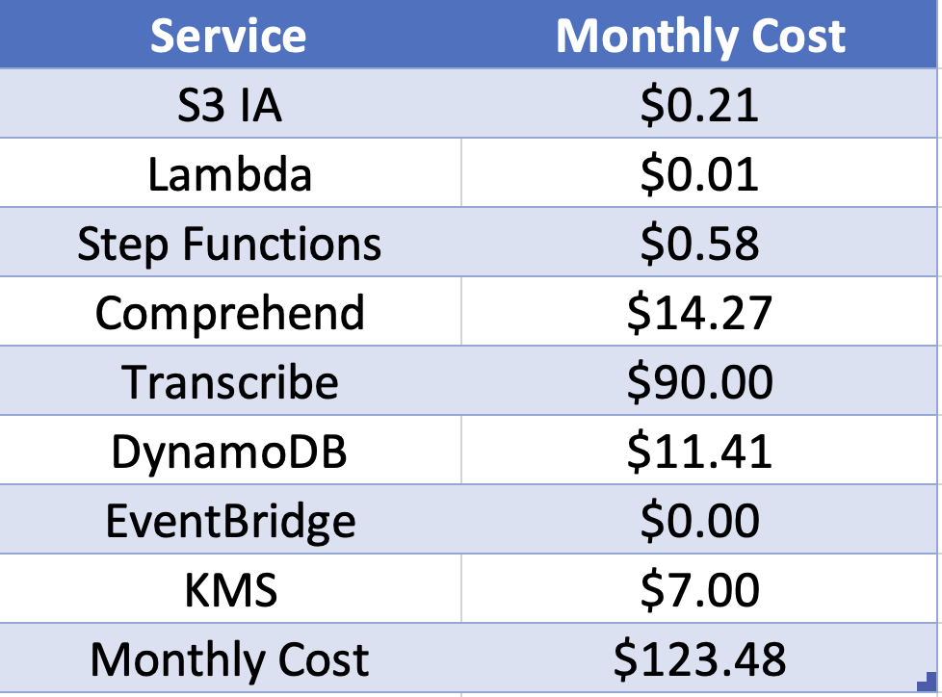
Cost & Assumptions
Back End Pipeline
20 Hours of MP3 Audio
Does not include website from demo
Does not include Free Tier
Start Up Cost:

Slide 9
Q&A

Slide 10

Jeremiah Webb
@illusjw

